Slide 1
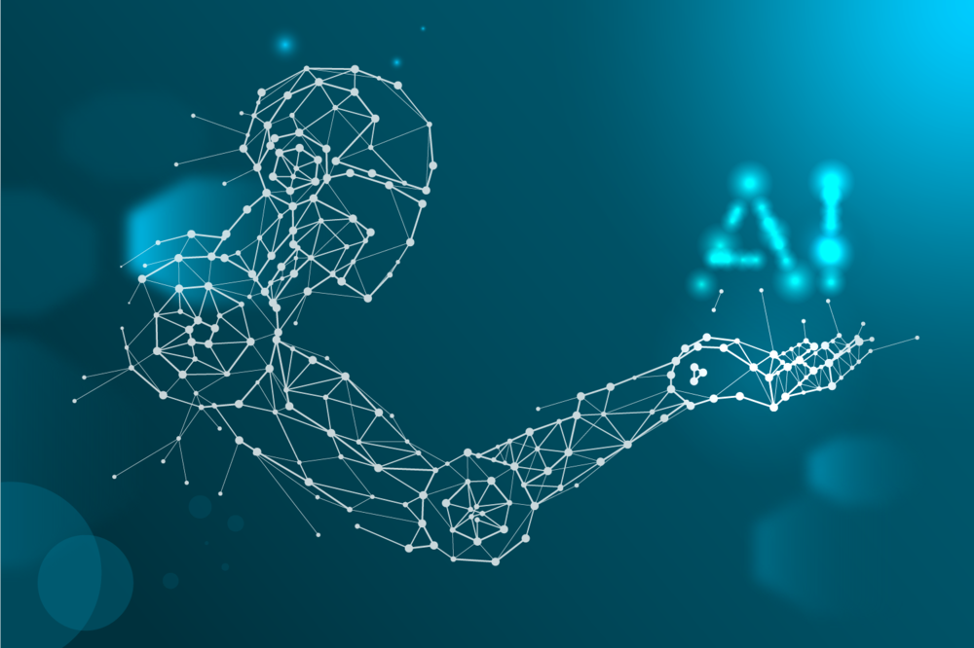
Introduction to Machine Learning and Artificial Intelligence
Presented by: Moran Davoodi

Slide 2
What is learning?
Learning is a process that leads to change, which occurs as a result of experience and increases the potential of improved performance
Learning is a process that leads to change, which occurs as a result of running through data and increases the potential of improved performance

Slide 3
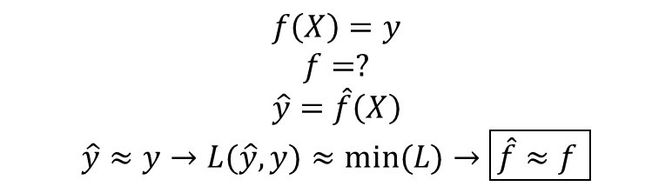
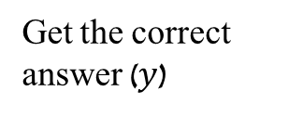
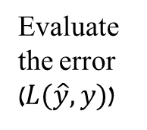
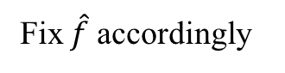
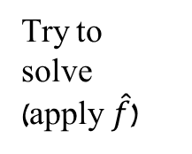
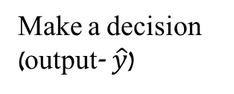
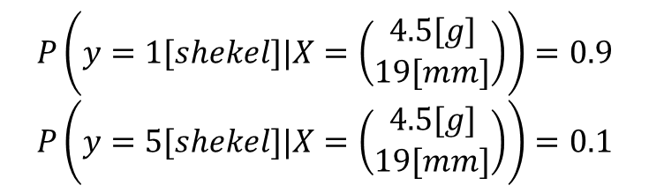
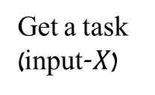
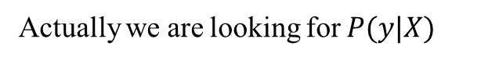
How do we learn?
At the end of the training period, we will apply what we have learned and hope for the best ☺
Try to solve (apply$\hat{f}$)
Make a decision (output- $\hat{y}$)
Get the correct answer ($y$)
Evaluate the error ($L(\hat{y},y)$)
Get a task (input-$X$)
Fix $\hat{f}$ accordingly
$$f\left(X\right)=y$$
$$f=?$$
$$\hat{y}=\hat{f}\left(X\right)$$
$$\hat{y}≈y→L(\hat{y},y)≈min⁡(L)→\boxed{\hat{f}≈f }$$
$$P\left(y=1[shekel]|X=\left(\begin{matrix}4.5[g] \\ 19[mm]\end{matrix}\right)\right)=0.9$$
$$P\left(y=5[shekel]|X=\left(\begin{matrix}4.5[g] \\ 19[mm]\end{matrix}\right)\right)=0.1$$
Actually we are looking for $P(y|X)$

Slide 4
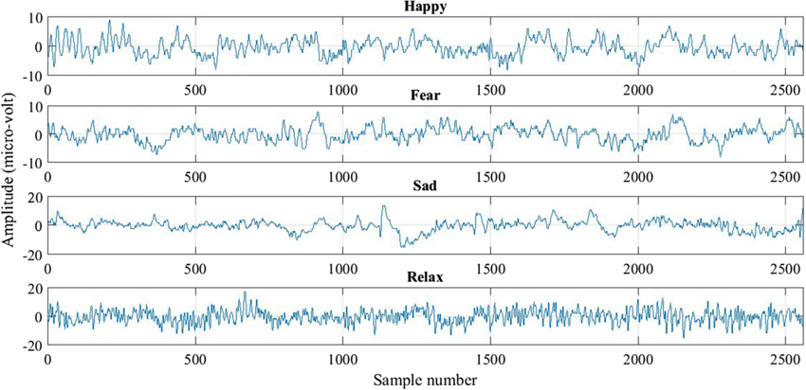
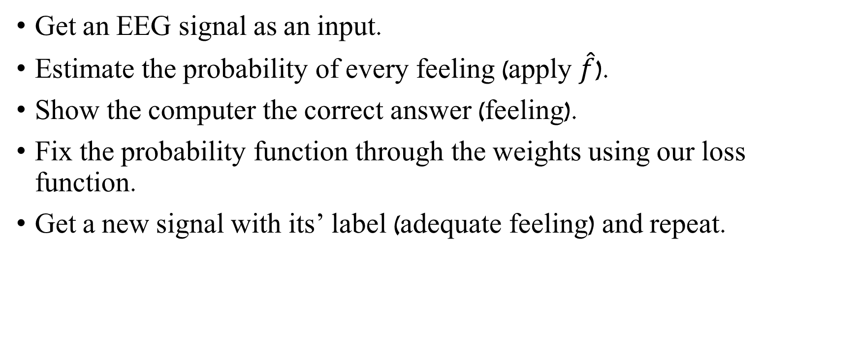
Estimating current feeling with EEG
Get an EEG signal as an input.
Estimate the probability of every feeling (apply $\hat{f}$).
Show the computer the correct answer (feeling).
Fix the probability function through the weights using our loss function.
Get a new signal with its’ label (adequate feeling) and repeat.

Slide 5
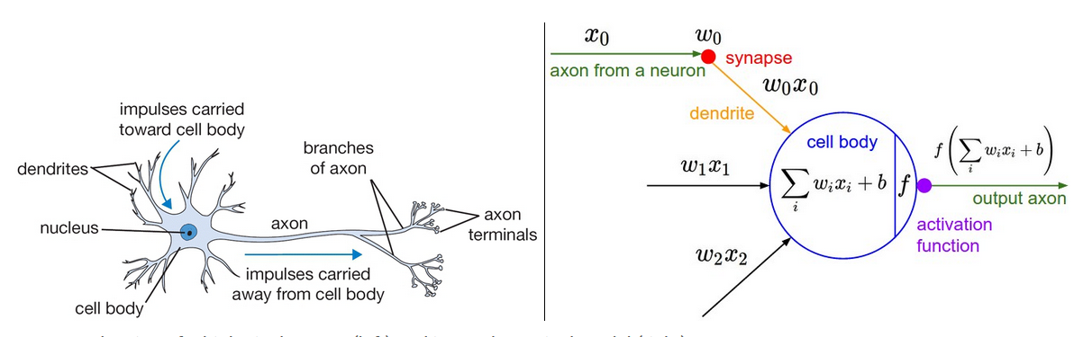
How do we decide?

Slide 6
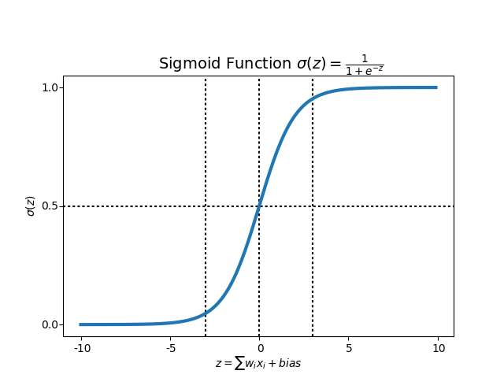
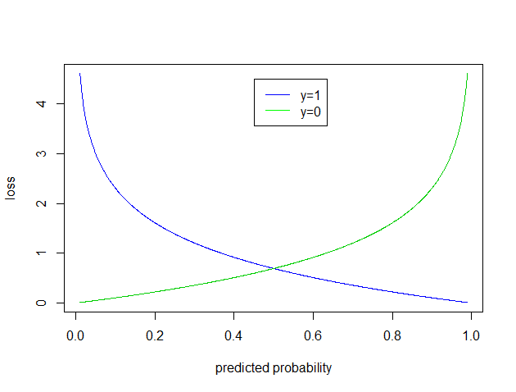
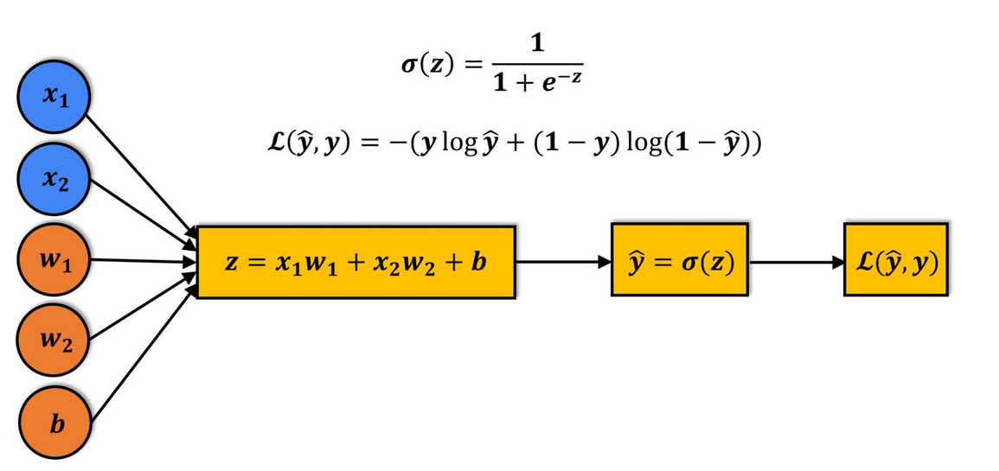
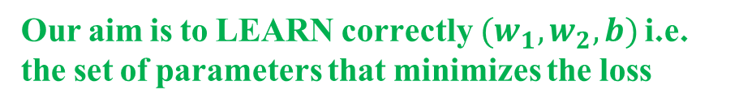
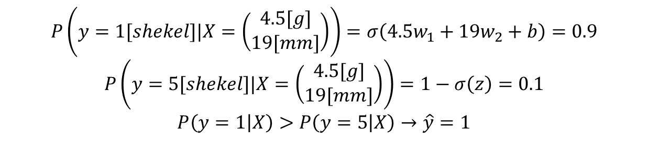
Weight
The idea of loss is saying “bad computer” when it is wrong. The loss is lower for “more correct” prediction and higher for “less correct”.
Diameter
$$P\left(y=1[shekel]|X=\left(\begin{matrix}4.5[g] \\ 19[mm]\end{matrix}\right)\right)=σ\left(4.5w_{1}+19w_{2}+b\right)=0.9$$
$$P\left(y=5[shekel]|X=\left(\begin{matrix}4.5[g] \\ 19[mm]\end{matrix}\right)\right)=1−σ\left(z\right)=0.1$$
$$P\left(y=1 | X\right)>P\left(y=5 | X\right)→\hat{y}=1$$
Our aim is to LEARN correctly $(w_{1},w_{2},b)$ i.e. the set of parameters that minimizes the loss

Slide 7
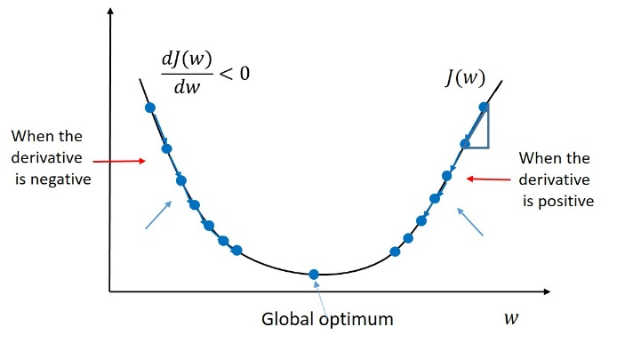
Calculus as learning factor

Slide 8
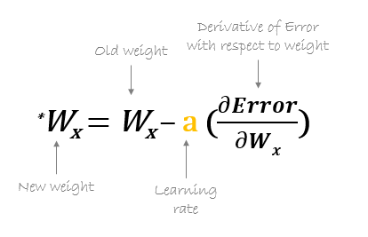
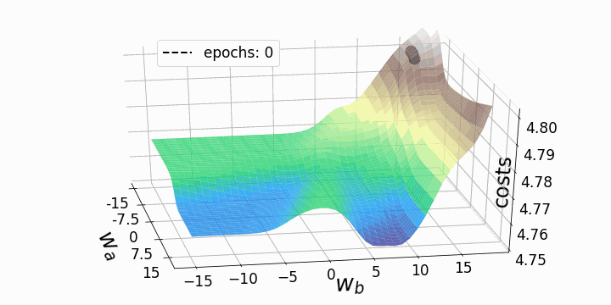
Gradient descent

Slide 9
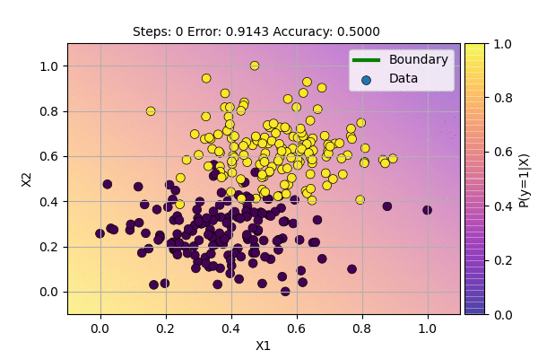
Visualize learning

Slide 10
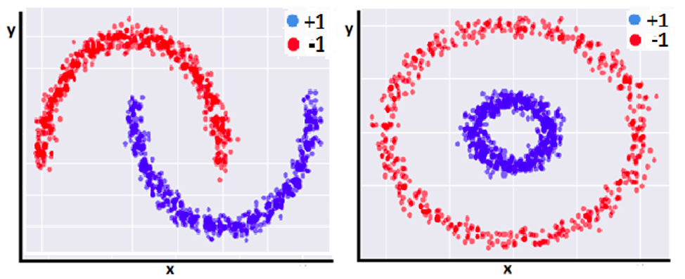
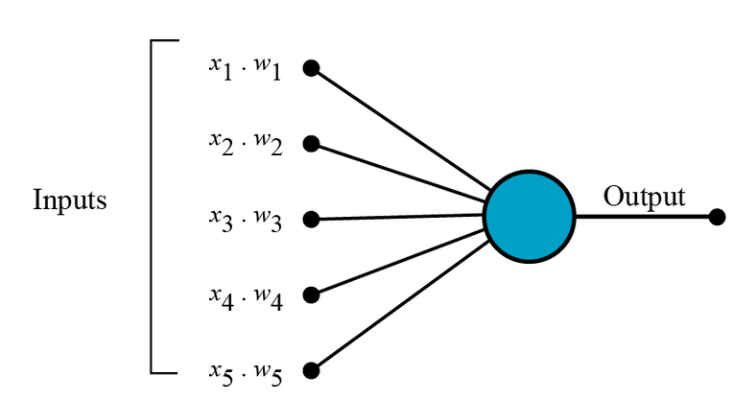
Why not stop here?

Slide 11
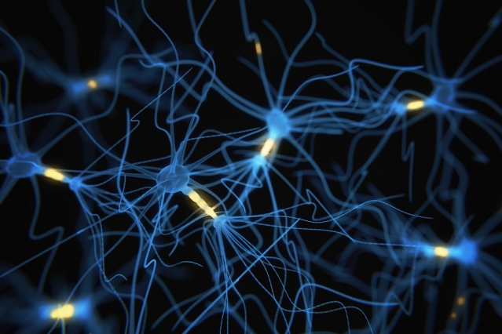
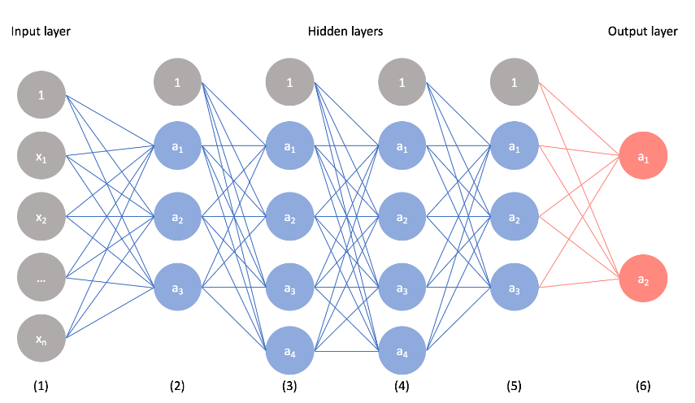
Mimicking our brain

Slide 12
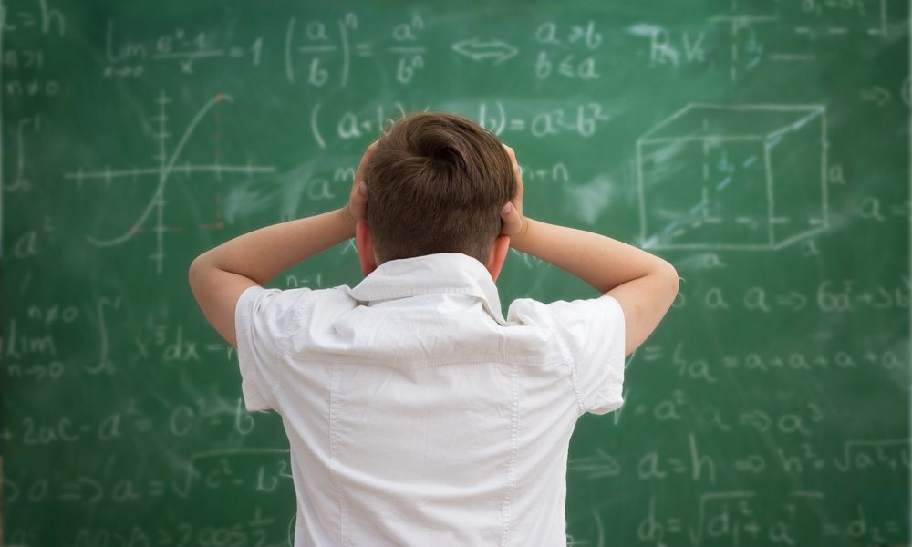

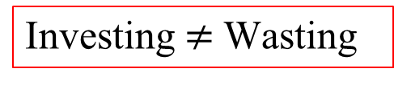
From feature engineering to representation learning
PSD
STD
Investing $≠$ Wasting

Slide 13
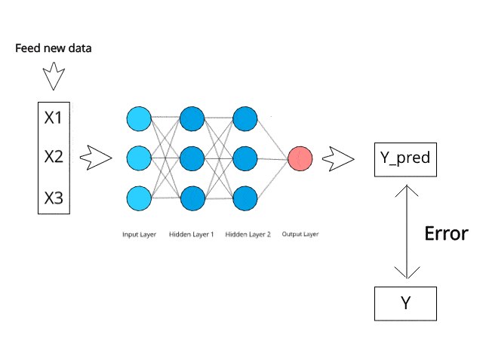

Slide 14
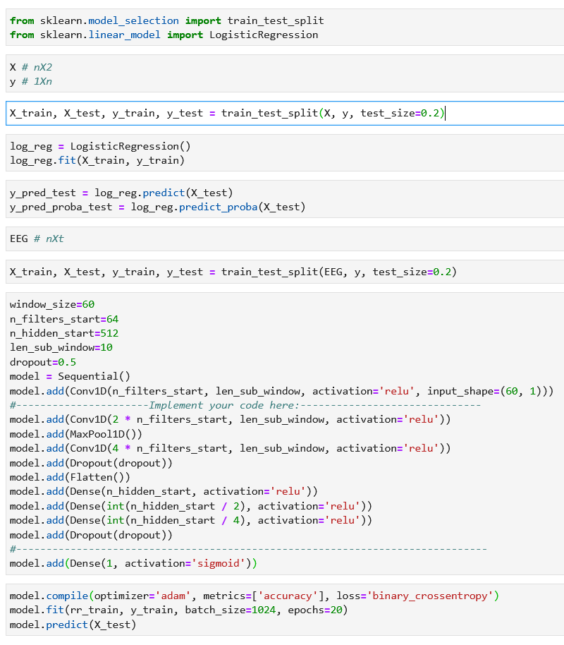
Hands on with Python

Slide 15
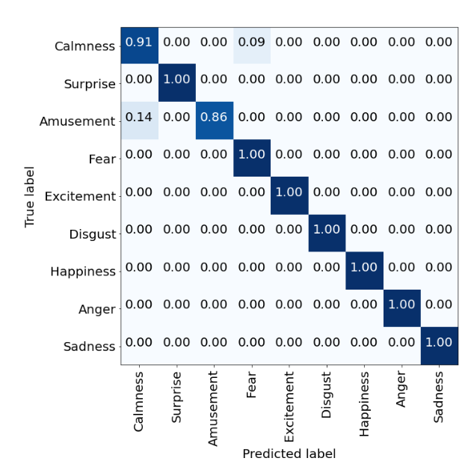
Results for NN

Slide 16
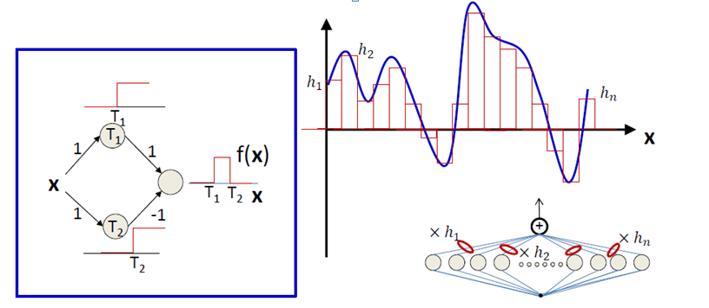

Slide 17
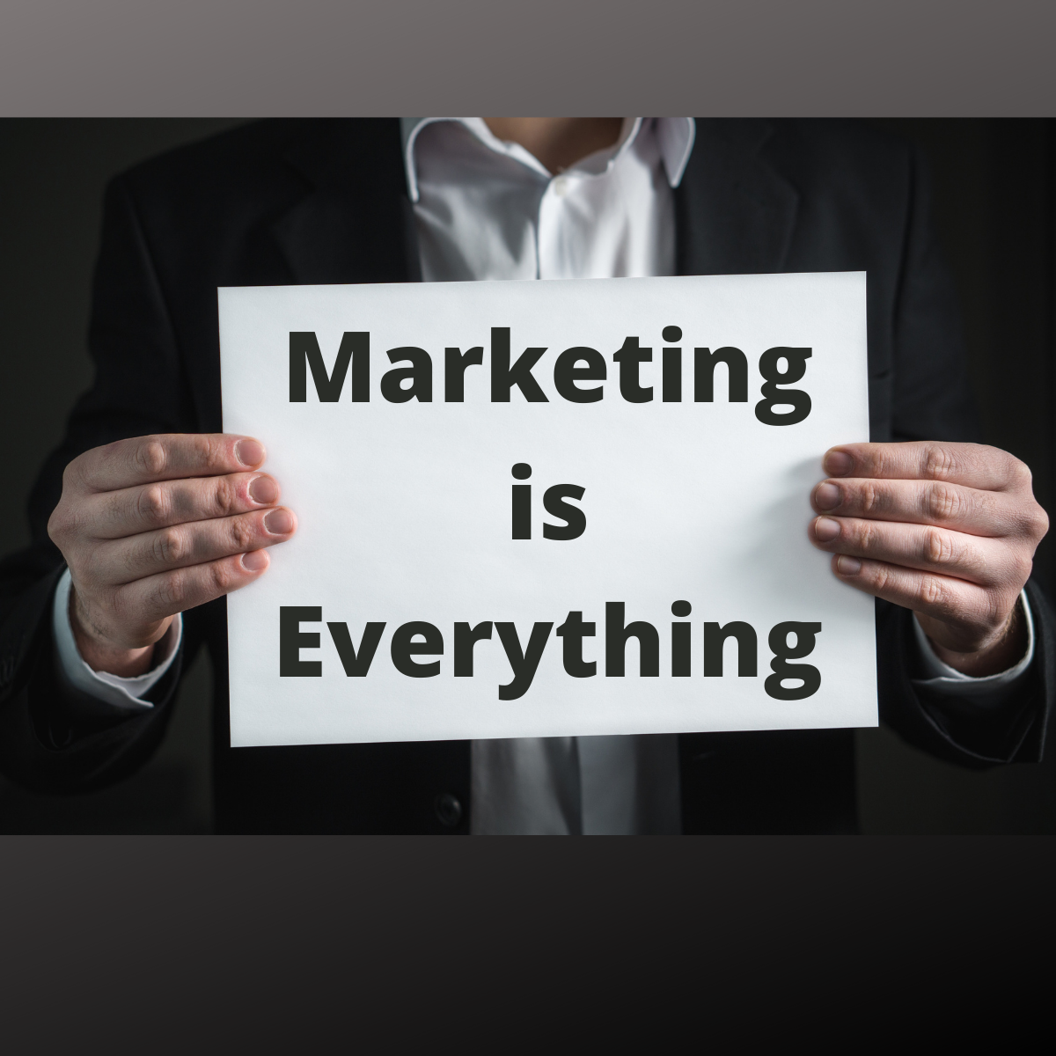
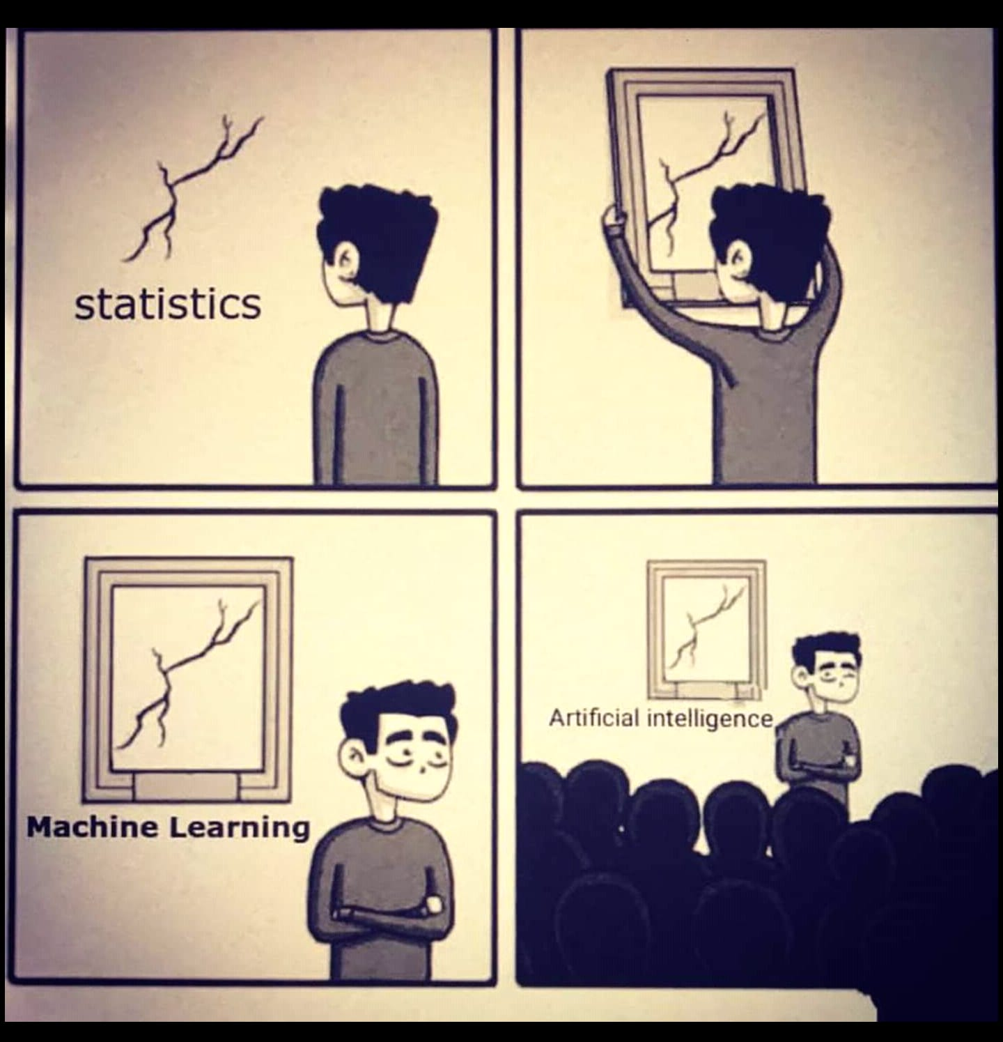
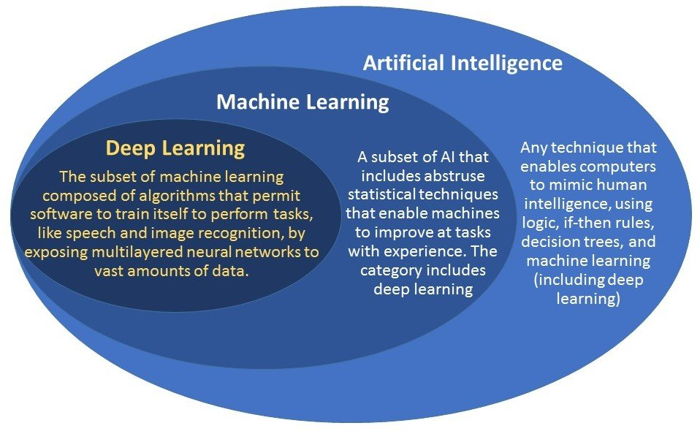

Slide 18
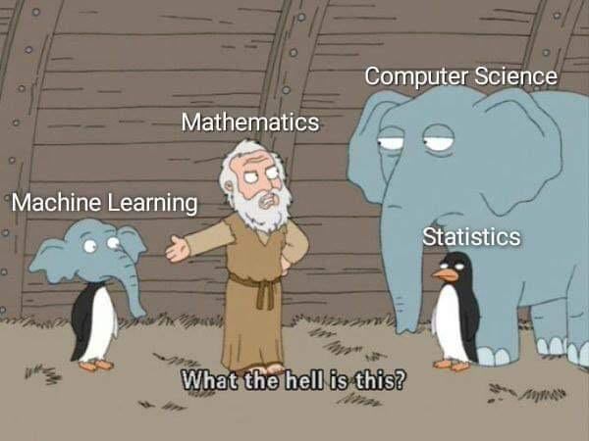

Slide 19
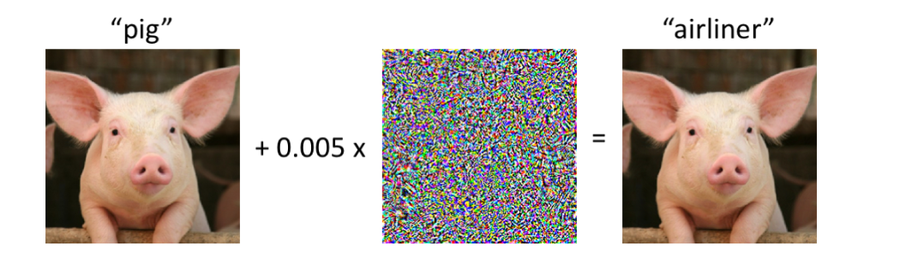
Why we should not throw away engineering

Slide 20
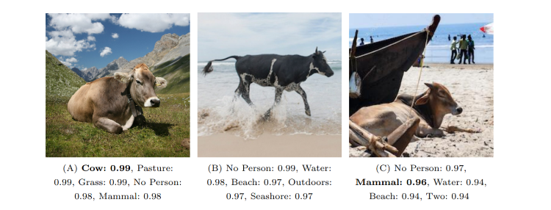
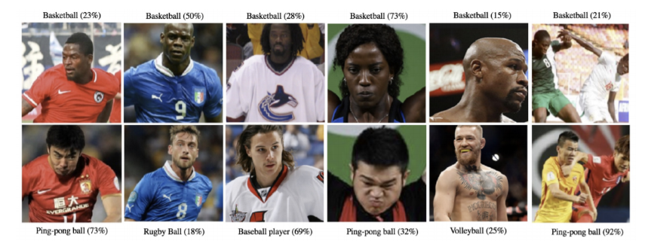

Slide 21
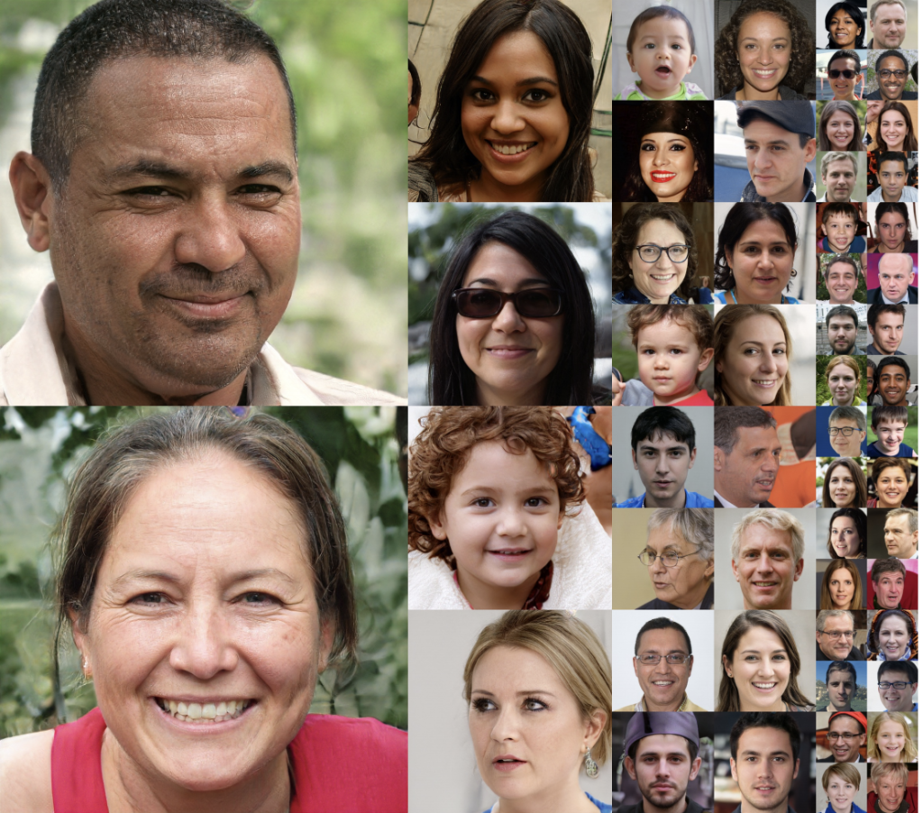
Beyond Classification

Slide 22
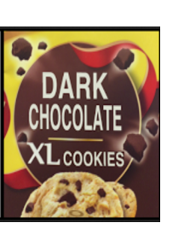
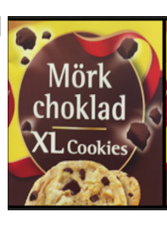
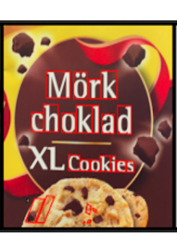
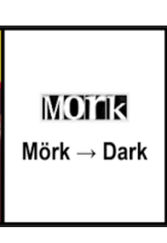
Beyond Classification

Slide 23
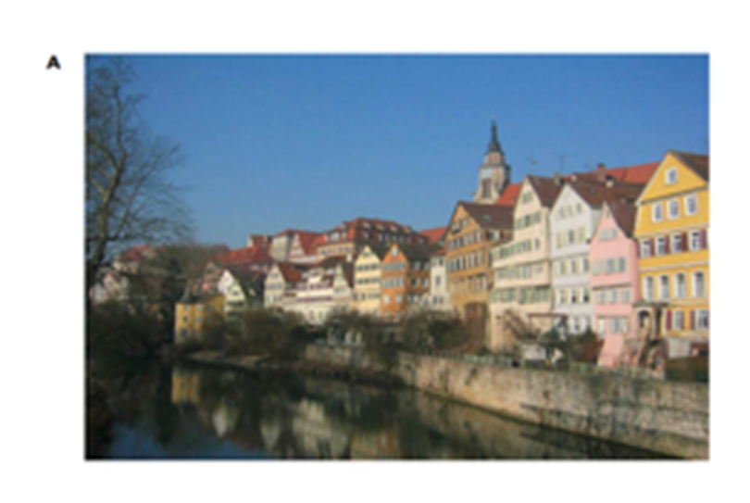
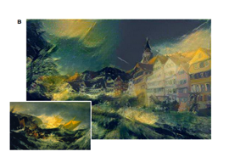
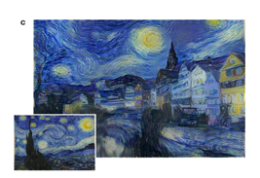
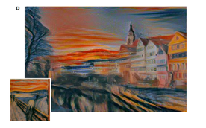

Slide 24


